Slide 1
How to win an argument
JONATHAN HABER

Slide 2
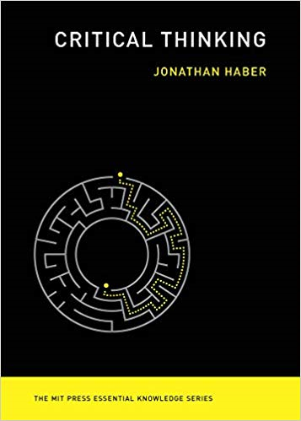
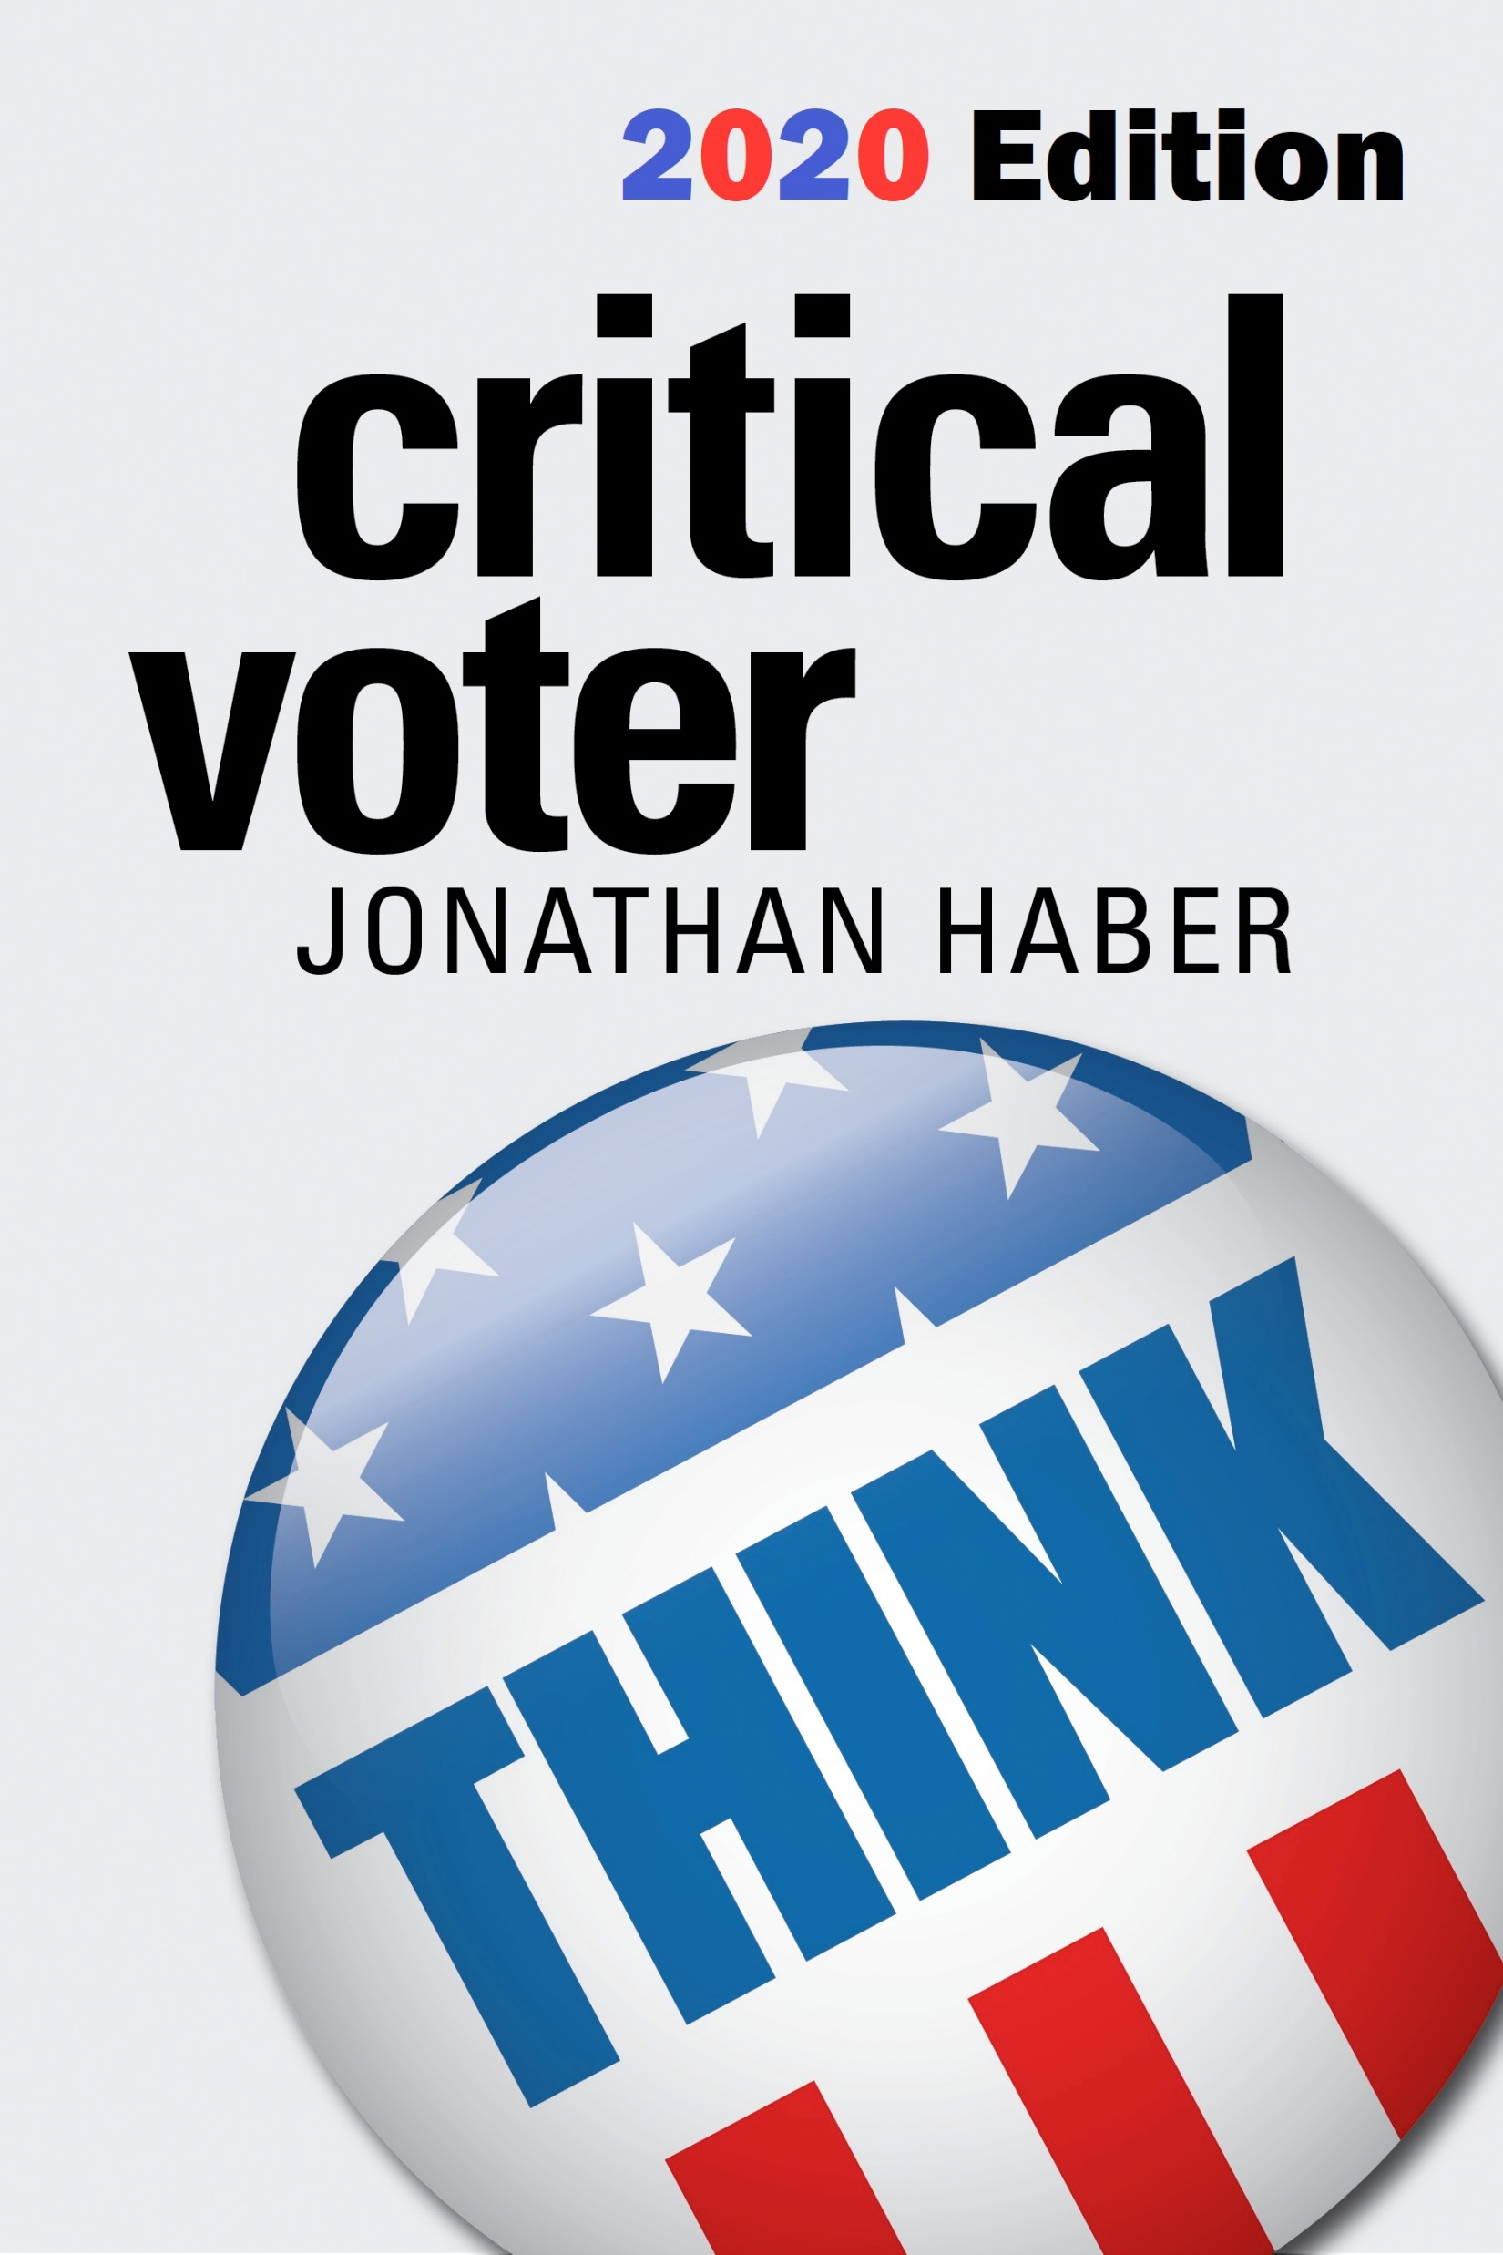
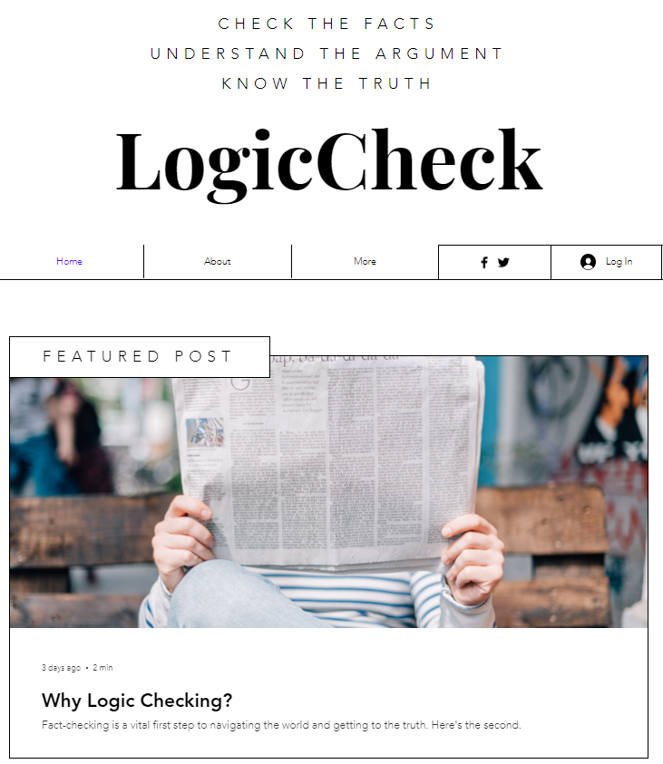
Critical thinking
MIT Press
criticalvoter.com
logiccheck.net

Slide 3
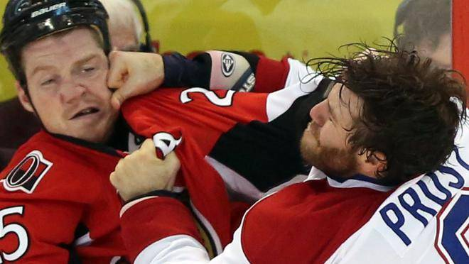
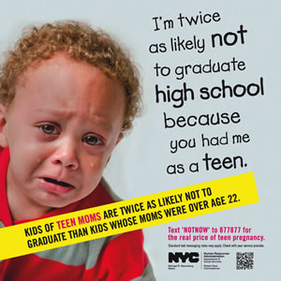
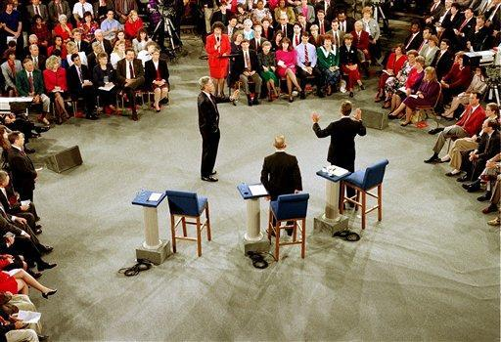
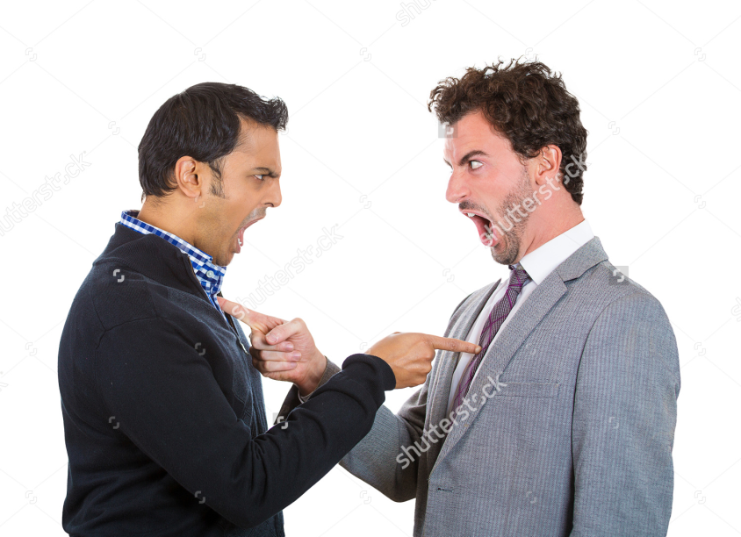
What is an argument?

Slide 4
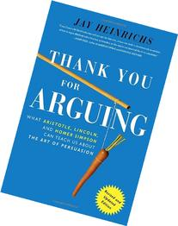
What is an argument?
“You fight to win,” he writes; “you argue to achieve agreement.”
Jay Heinrichs
Author, Thank You for Arguing

Slide 5
How to win an argument
  Background Knowledge (Research, Media and Information Literacy)
  Logic
  Argumentation
  Modes of Persuasion/Knowing Your Audience
  Rhetoric
  Cognitive Science

Slide 6
EXAMPLE
We’ve been holed up in the house for months going stir crazy and the number of deaths from Coronavirus keeps going up. Clearly, social distancing isn’t working!

Slide 7
translation
Premise 1: Harsh social-distancing practices have been in place for months.
Premise 2: During that time, the number of deaths from Coronavirus has gone up.
Conclusion: Harsh social-distancing practices are not stopping the spread of Coronavirus.

Slide 8
Test for validity
Premise 1: Harsh social-distancing practices have been in place for months.
Premise 2: During that time, the number of deaths from Coronavirus has gone up.
Conclusion: Harsh social-distancing practices are not stopping the spread of Coronavirus.
Validity

Slide 9
Test for validity
Premise 1: Harsh social-distancing practices have been in place for months.
Premise 2: During that time, the number of deaths from Coronavirus has gone up.
Conclusion: Harsh social-distancing practices are not stopping the spread of Coronavirus.
Not Valid

Slide 10
Hidden premise
Premise 1: Harsh social-distancing practices have been in place for months.
Premise 2: During that time, the number of deaths from Coronavirus has gone up.
Premise 3 [hidden]: Social distancing practices should lead to an immediate reduction in deaths from Coronavirus.
Conclusion: Harsh social-distancing practices are not stopping the spread of Coronavirus.

Slide 11
Test for soundness
Premise 1: Harsh social-distancing practices have been in place for months
Premise 2: During that time, the number of deaths from Coronavirus has gone up.
Premise 3 [hidden]: Social distancing practices should lead to an immediate reduction in deaths from Coronavirus.
Conclusion: Harsh social-distancing practices are not stopping the spread of Coronavirus.
Soundness

Slide 12
Test for soundness
Premise 1: Harsh social-distancing practices have been in place for months
Premise 2: During that time, the number of deaths from Coronavirus has gone up.
Premise 3 [hidden]: Social distancing practices should lead to an immediate reduction in deaths from Coronavirus.
Conclusion: Harsh social-distancing practices are not stopping the spread of Coronavirus.
Not Sound

Slide 13
How to win an argument
  Background Knowledge (Research, Media and Information Literacy)
  Logic
  Argumentation
  Modes of Persuasion/Knowing Your Audience
  Rhetoric
  Cognitive Science

Slide 14
Modes of persuasion
  Logos - Logic
  Pathos - Emotion
  Ethos - Connection

Slide 15
audience
The Moderator
The Other Candidates
The People in the Room
People Watching the Debate on Television

Slide 16
Types of arguments
  Forensic Arguments
  Demonstrative Arguments
  Deliberative Arguments

Slide 17
How to win an argument
  Create arguments that are:
  Based on sound understanding (know what you’re talking about)
  Logically coherent (premises lead to the conclusion)
  Identity and needs of the audience are taken into account
  Correct balance of logic, emotion and connection to the audience (ethos)
  Carried on in the proper tense (past, present or future)
  Principled goals and a desire to achieve agreement or understanding

Slide 18
Rhetorical devices
https://www.youtube.com/watch?v=LHjbQ3CUsZ8

Slide 19
Rhetorical devices
  Linguistic devices
    Literary (metaphor, alliteration, assonance, consonance, rhyming)
    Oral (anaphora, tricolon, chiasmus)
  Strategic devices
    Procatolepsis
    Rhetorical Questions
    Innuendo
    Story-formation

Slide 20
bias
https://www.youtube.com/watch?v=vJG698U2Mvo

Slide 21
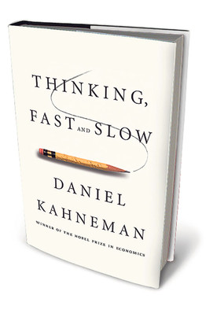
Cognitive biases
Examples of biases:
Anchoring
Framing
Bandwagon Effect
Halo Effect
Confirmation Bias

Slide 22
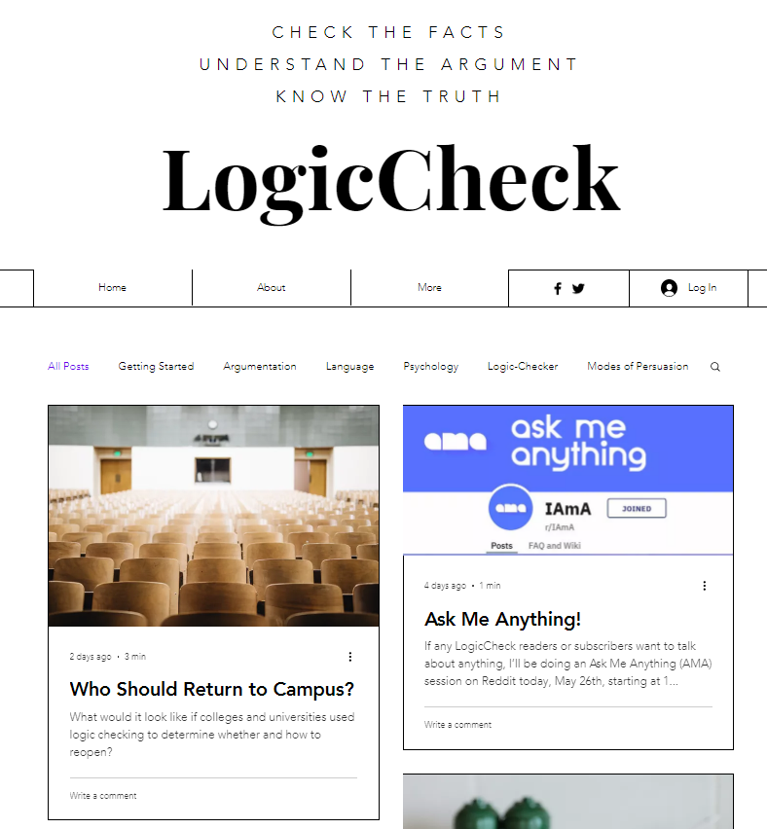
Learn more
www.logiccheck.net

Slide 23
Q&A

